Slide 1
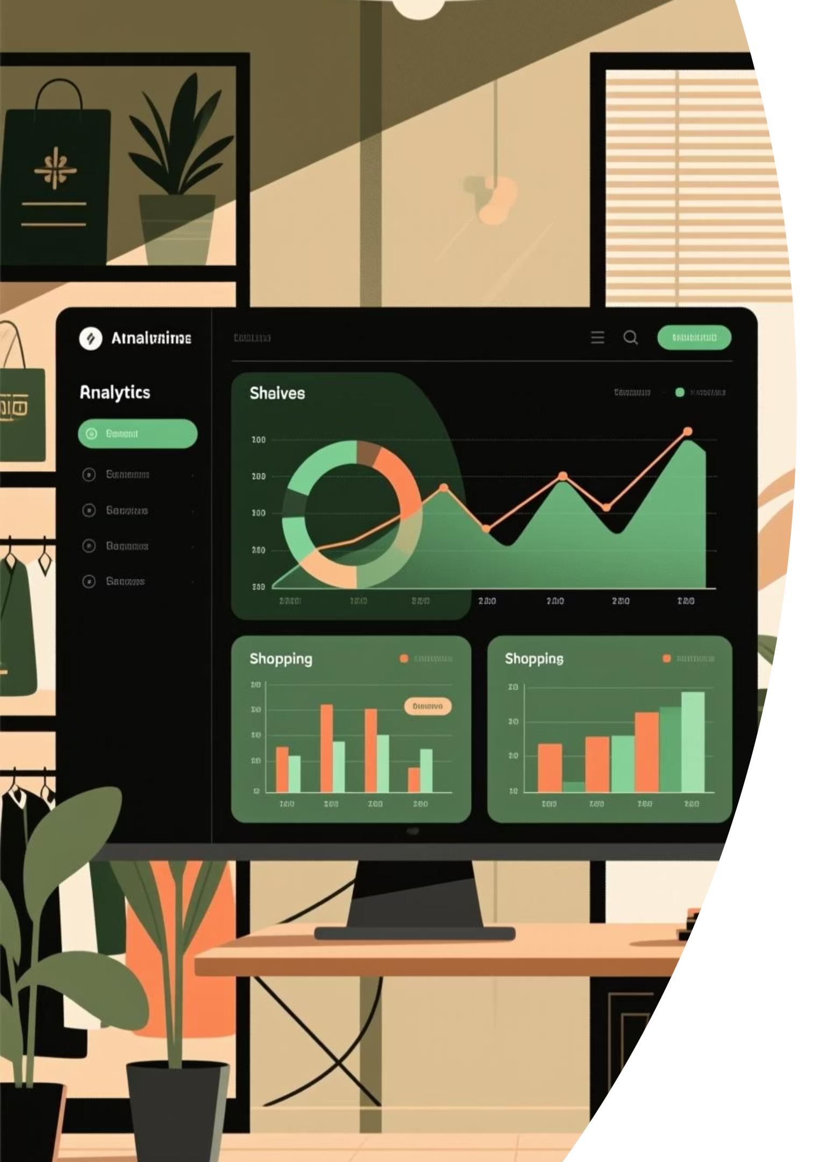
Customer Behavior Analysis
Uncovering insights from 3,900 customer transactions to drive strategic business decisions through data-driven analysis of spending patterns, segmentation, and product preferences.

Slide 2
Dataset Overview
3,900
18
50
25
Total Records
Key Features
Locations
Products
Customer transactions analyzed
Attributes tracked per customer
Geographic coverage
Items in catalog
Customer Demographics
Shopping Behavior
Age, Gender, Location
Purchase frequency and history
Subscription Status
Discount and promo usage
Review ratings and shipping preferences

Slide 3
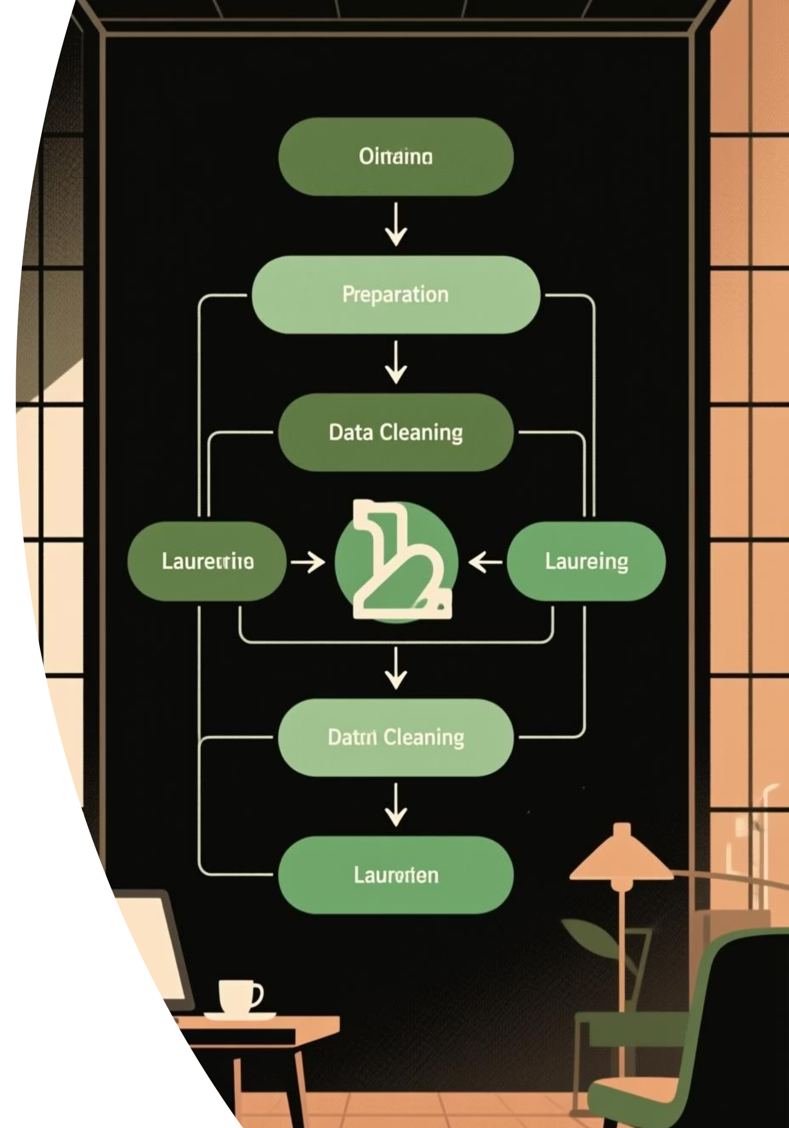
Data Preparation Process
01
Data Loading & Exploration
Imported dataset using pandas and inspected structure with df.info() and .describe() for summary statistics.
02
Handling Missing Values
Identified 37 missing values in Review Rating column and imputed using median rating per product category.
03
Feature Engineering
Created age_group categories and purchase_frequency_days from historical data for deeper insights.
04
Database Integration
Connected cleaned DataFrame to PostgreSQL for advanced SQL-based business analysis.

Slide 4
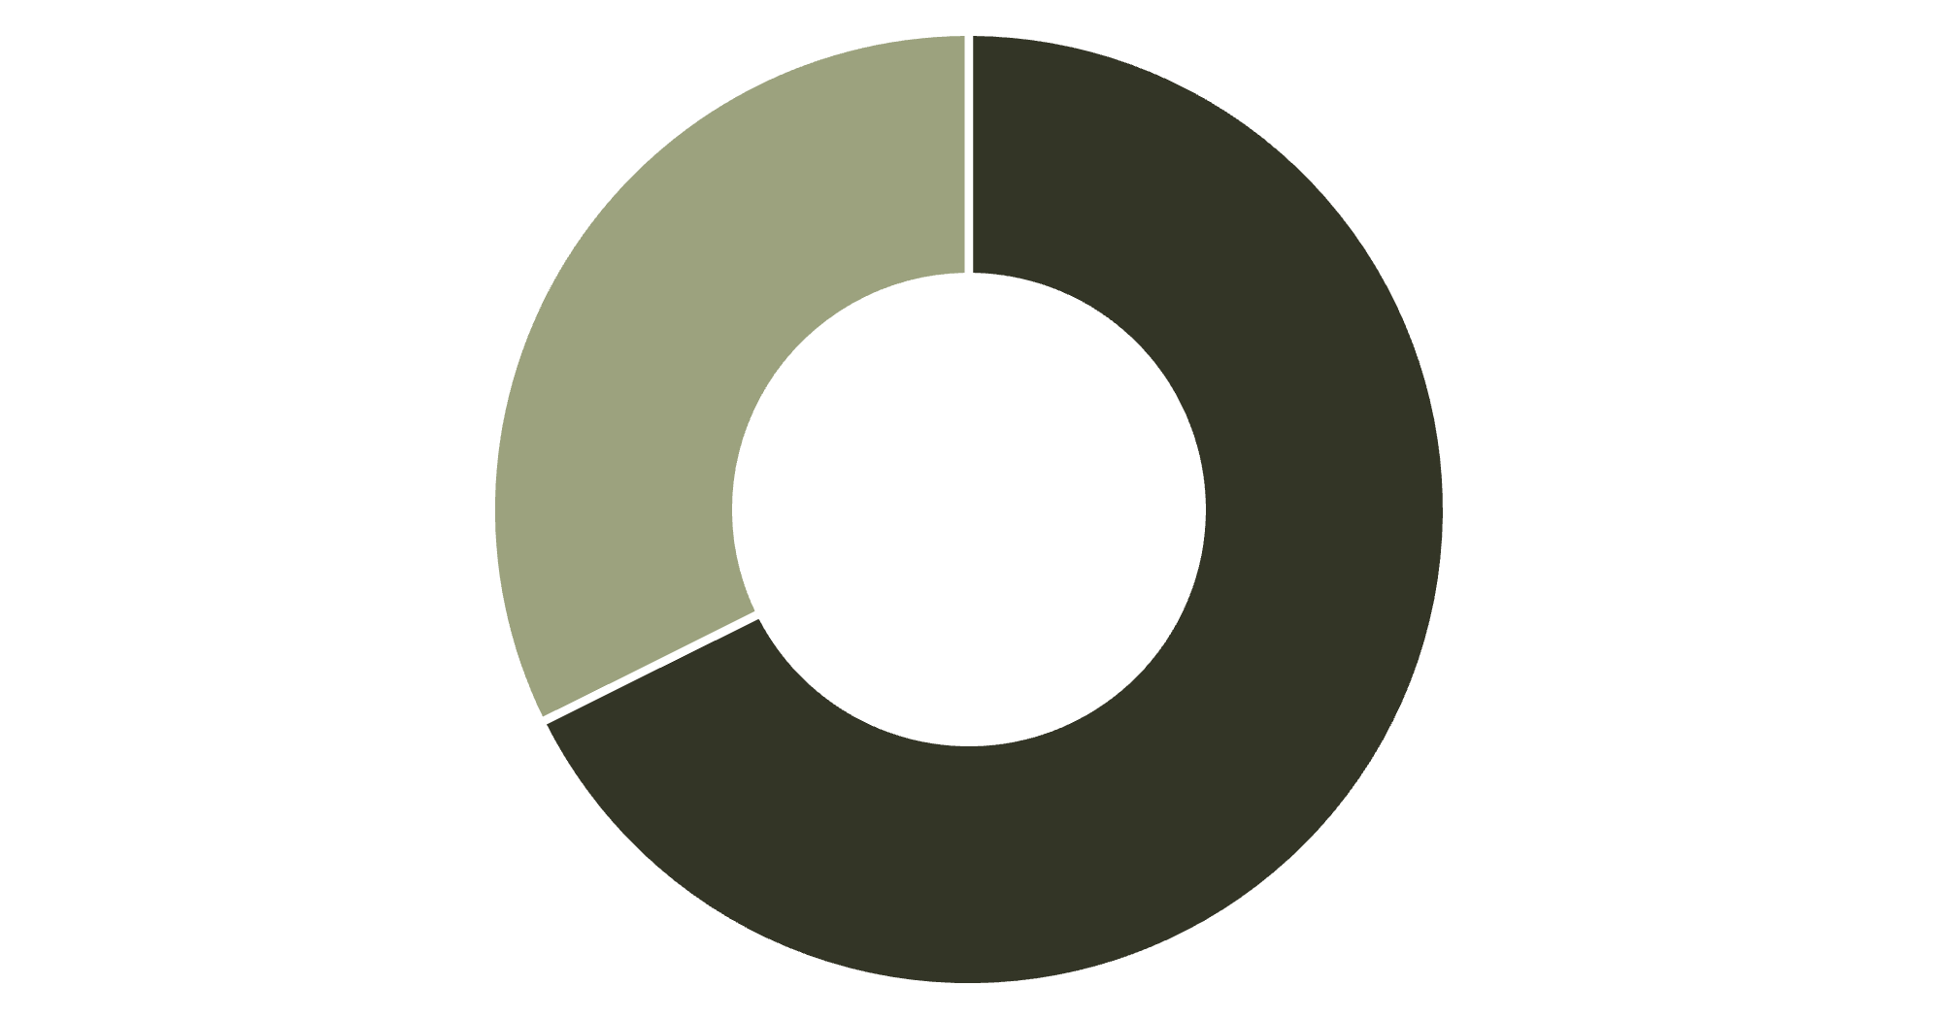
Revenue Analysis by Gender
Key Finding
Male customers generate $157,890 in revenue compared to $75,191 from female customers, representing a 2:1 ratio.
This significant disparity suggests opportunities for targeted marketing campaigns to increase female customer engagement.
Male
Female

Slide 5
Product Performance Insights
1
2
3
Gloves
Sandals
Boots
Average Rating: 3.86
Average Rating: 3.84
Average Rating: 3.82
4
5
Hat
Skirt
Average Rating: 3.80
Average Rating: 3.78
Top-rated products show consistent quality across accessories, footwear, and clothing categories. These items should be prominently featured in marketing campaigns.

Slide 6

Shipping & Discount Patterns
Shipping Type Comparison
Discount-Dependent Products
Express: $60.48 average
Hat (50% discount rate)
Standard: $58.46 average
Sneakers (49.66%)
Express shipping users spend slightly more per transaction, indicating higher-value customer segment.
Coat (49.07%)
Sweater (48.17%)
Pants (47.37%)

Slide 7



Customer Segmentation
New
1
83 customers
Returning
2
701 customers
Loyal
3
3,116 customers
The customer base is dominated by loyal customers (80%), indicating strong retention. However, the small new customer segment (2%) suggests a need for acquisition strategies.

Slide 8
Subscription Analysis
Subscriber vs. Non-Subscriber Spend
Repeat Buyers & Subscriptions
Subscribers: 1,053 customers, $59.49 avg spend
Among customers with 5+ purchases:
Non-Subscribers: 2,847 customers, $59.87 avg spend
958 have subscriptions
Similar spending patterns suggest subscription value proposition needs strengthening.
2,518 do not have subscriptions
Significant opportunity to convert loyal customers into subscribers.

Slide 9
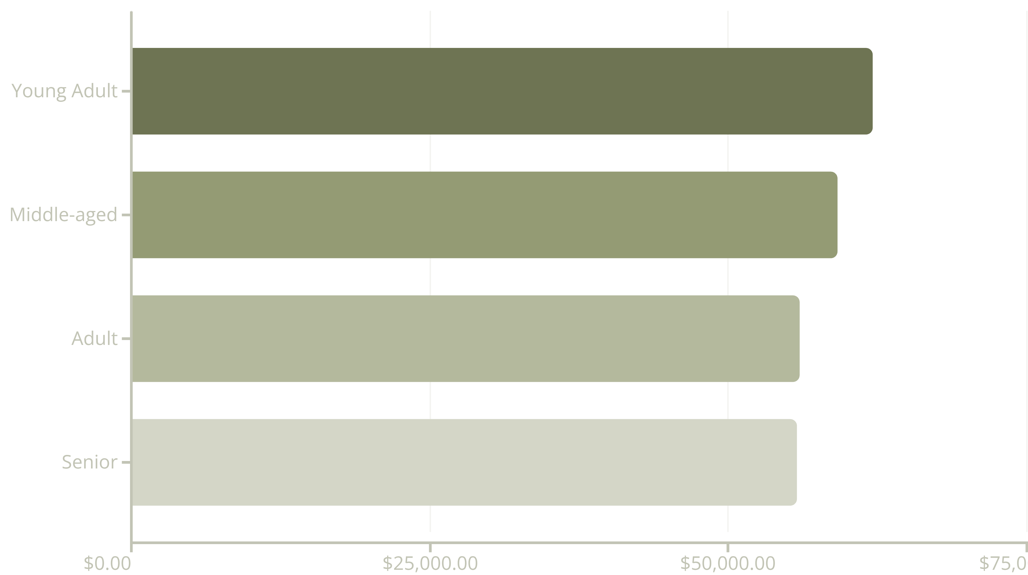
Revenue by Age Group
Young adults generate the highest revenue at $62,143, followed closely by middle-aged customers. Revenue distribution is relatively balanced across age groups.

Slide 10

Strategic Recommendations
Boost Subscriptions
Loyalty Programs
Offer exclusive perks and targeted campaigns to convert loyal customers into subscribers.
Reward returning customers to transition them into the loyal segment and increase lifetime value.
Review Discount Policies
Enhanced Marketing
Balance promotional discounts with profitability, especially for discount-dependent products.
Promote top-rated products and target high-revenue age groups for better ROI.

